Slide 1
Colors
#62B6CB
#FB8500
#023047
#FFB703

Slide 2









Step 1
Liam Murphy
Policy ID 4532609
Policy Details
File a Claim
Manage Claims

Slide 3




Step 2
Policy Details
Policy ID 4532609
Policyholder Details:
Full Name: Liam Murphy
Date of Birth: 31/07/1984
40 Years old
Nationality: Irish
Vehicle Details:
Brand Model: Toyota Yaris
Registration Date: 29/07/2021
3 Years old
Residence Details:
County: Dublin

Slide 4
Step 3
Liam Murphy
Policy ID 4532609
Policy Details
File a Claim
Manage Claims

Slide 5

Step 4
File a Claim
Policy ID 4532609
Open a New Claim

Slide 6
Step 5
File a Claim
Policy ID 4532609
Claim ID 29382921
Date
Enter the Claim Date
Time
Enter the Claim Time
Do you need road assistance?
Enter Yes / No
Claim Details Picture
Upload Photo

Slide 7

Step 6
File a Claim
Policy ID 4532609
Claim ID 29382921
Claim Processing
Please remain calm we this will take only a few seconds…

Slide 8

Step 7.1 – if road assistance needed or damage not modeled
File a Claim
Policy ID 4532609
Claim ID 29382921
Pending Approval
You will be called in the following minutes by one of our claim handlers

Slide 9


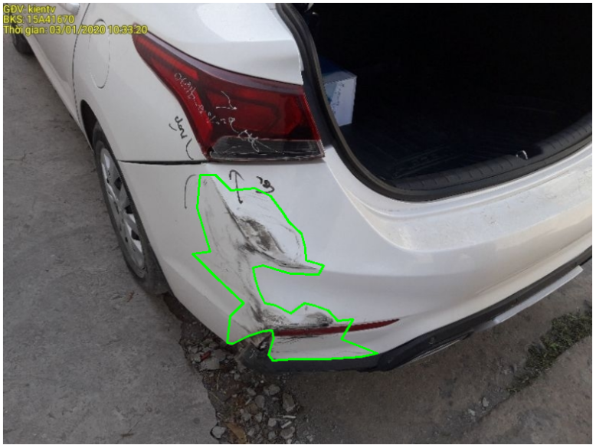
Step 7.2 – Approved
Policyholder View
Claim Handler View
File a Claim
Policy ID 4532609
Open Claims
Claim ID 29382921
Approved
Claim ID 29382921
Thank you for your patience
Policy ID: 4532609
Date: 29/07/2024
Workshop: Sandyford McCann Motors
Status: Approved
Workshop for Vehicle Reparation
Opening Reserve:
€342
Sandyford McCann Motors
Paint Scratches 1:
342€
Schedule the appointment
27/08/2024

Slide 10
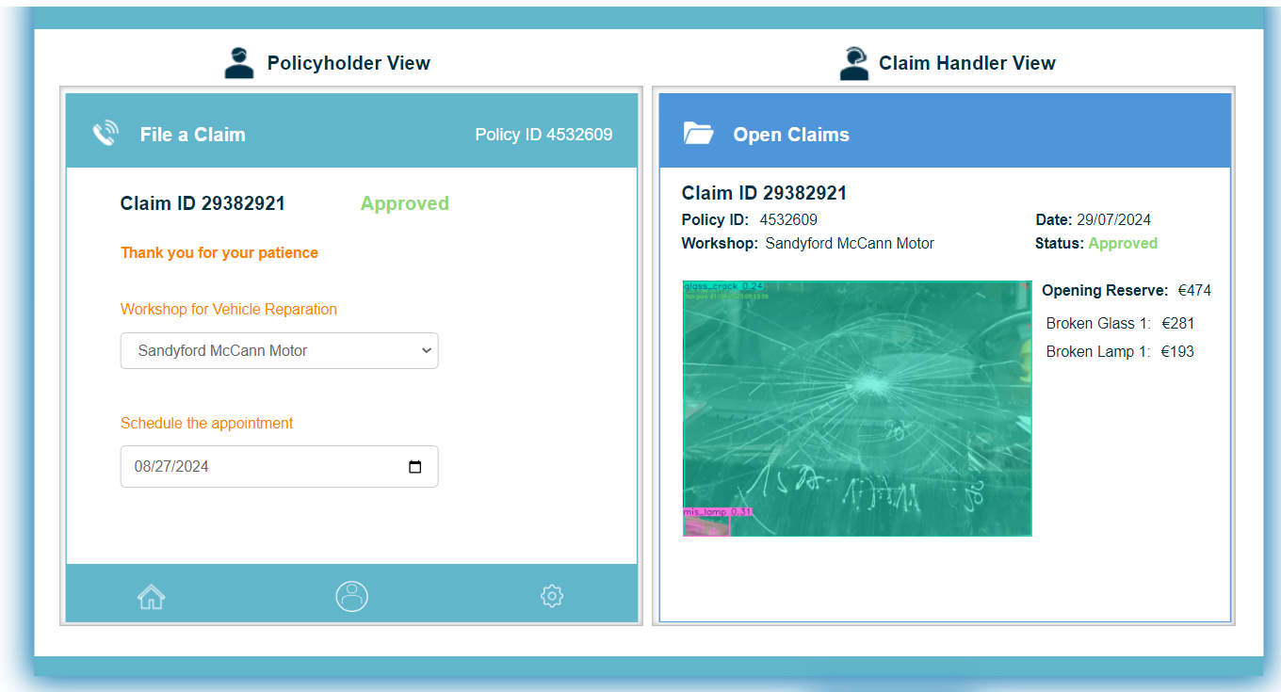
Step 7.2 – Approved – Example 2

Slide 11
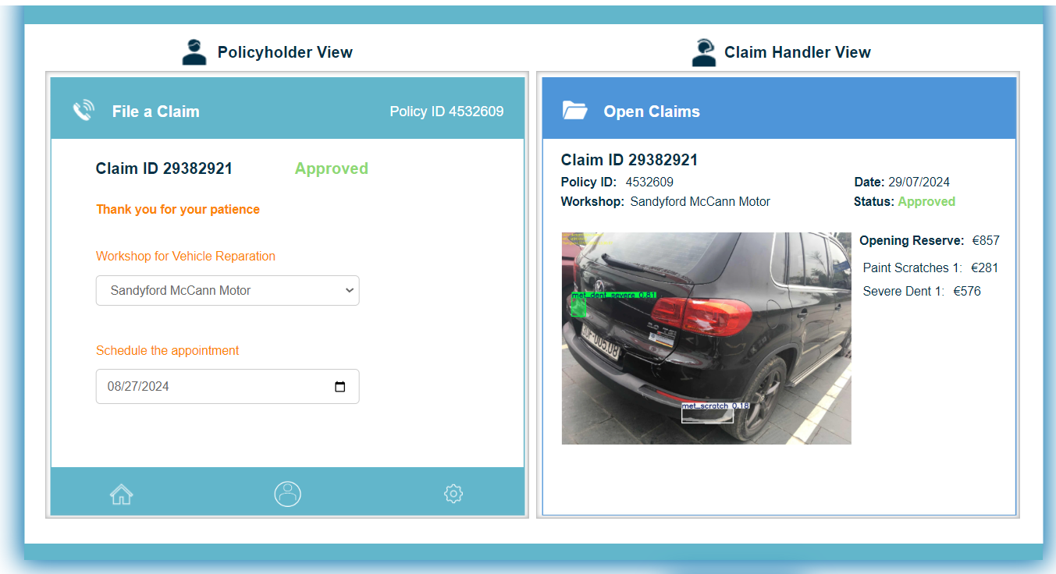
Step 7.2 – Approved – Example 1

Slide 12
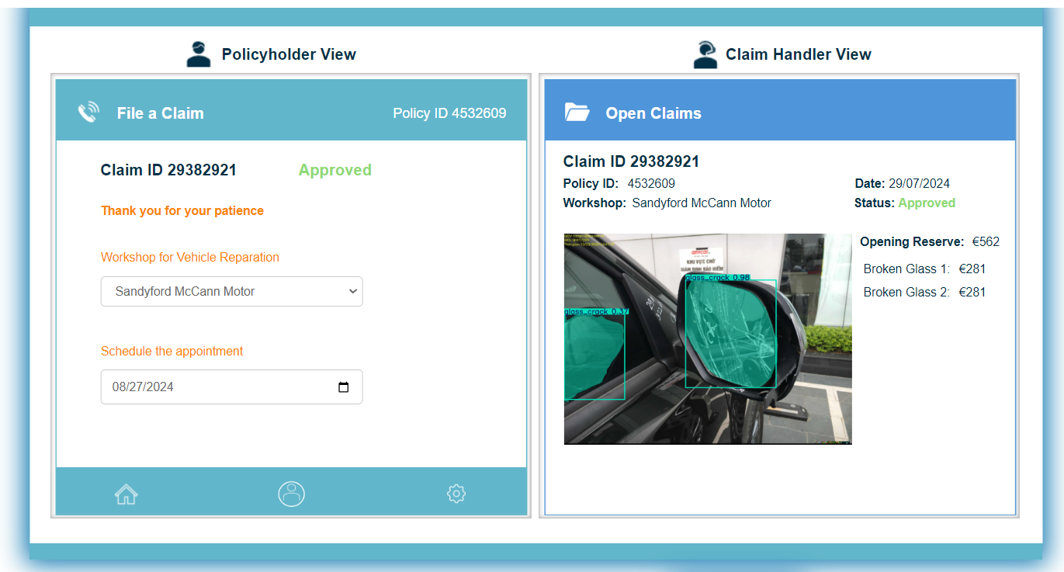
Step 7.2 – Approved – Example 4

Slide 13
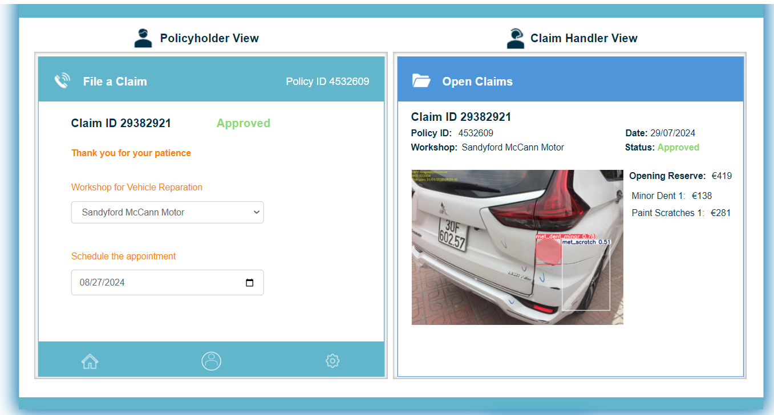
Step 7.2 – Approved – Example 3

Slide 14
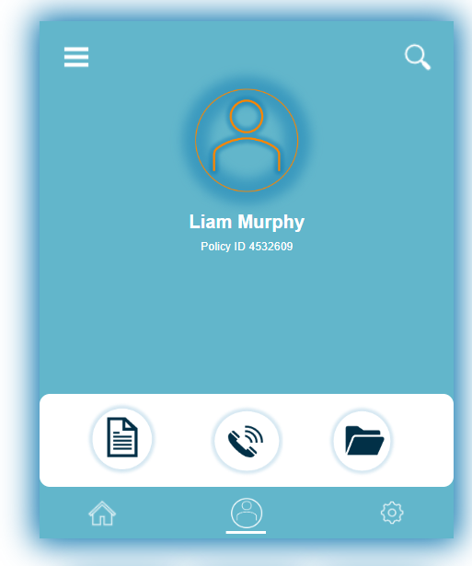
Step 3

Slide 15
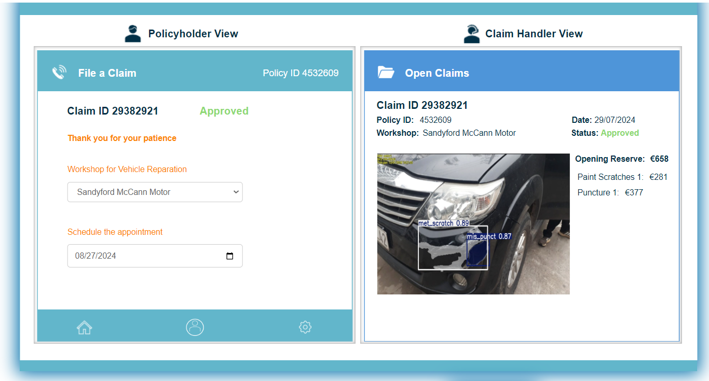
Step 7.2 – Approved – Example 5

